Slide 1

IOT Based Pulse Monitoring System
By: GROUP 21 ECE
SUBHASHIS DUTTA
SUDHYABRATA GUHA
SUPROTIM DATTA
SHUBHAM KUMAR
AKASH CHANDRA KUNDU

Slide 2
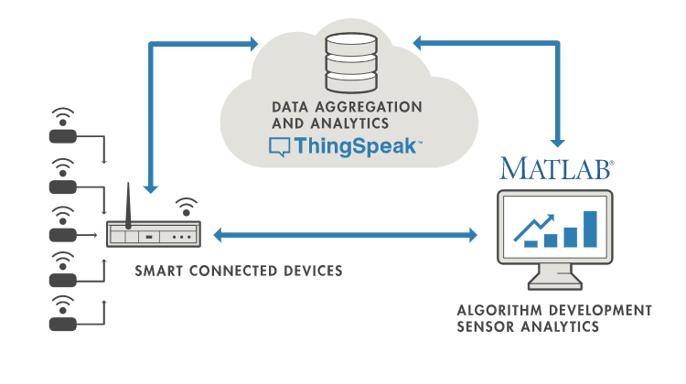
The Pulse Monitoring system is developed using IOT technology with an objective of detecting the pulse rate of the patient. With the help of iot application it can be monitored from anywhere in the world.
What is an IOT Based Pulse Monitoring System ?
WE’VE USED THINGSPEAK, AN IOT ANALYTICS PERFORM SERVICE TO MONITOR THE PULSE RATE OF THE PATIENT

Slide 3
1. NODEMCU ESP8266 2. PULSE SENSOR 3. JUMPER WIRES
COMPONENTS USED

Slide 4
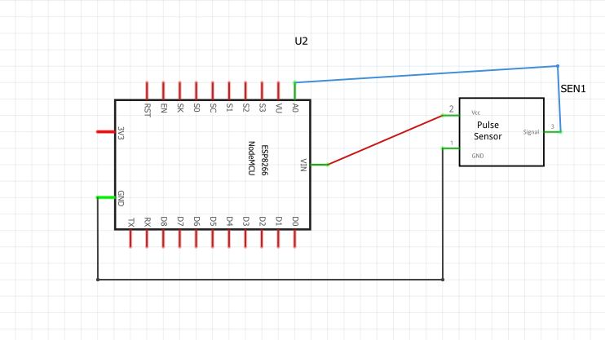
CIRCUIT DIAGRAM

Slide 5
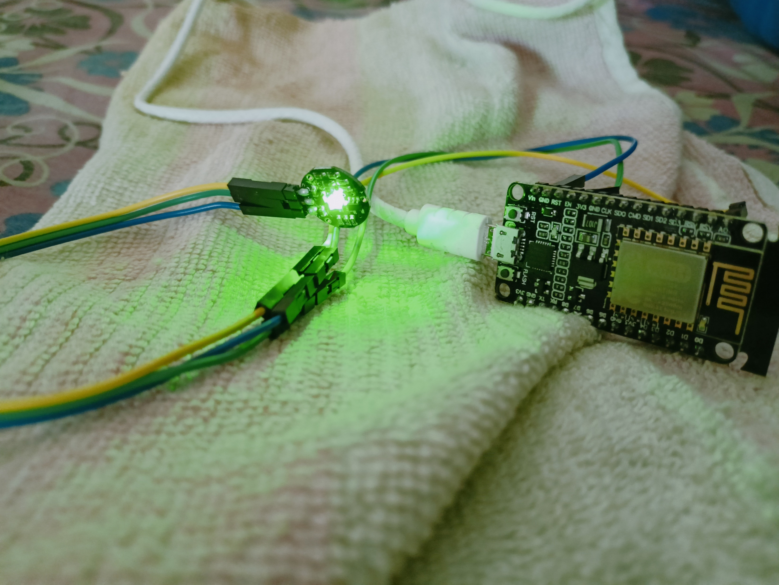
THE CIRCUIT
The pulse sensor is connected to nodemcu esp8266 with the help of jumper wires. The pins of esp8266 connected are GND,A0 & Vin. The circuit is connected to the laptop using a data cable.

Slide 6
1. ARDUINO IDE 2. THINGSPEAK
PLATFORMS IMPLEMENTED IN THIS PROJECT

Slide 7
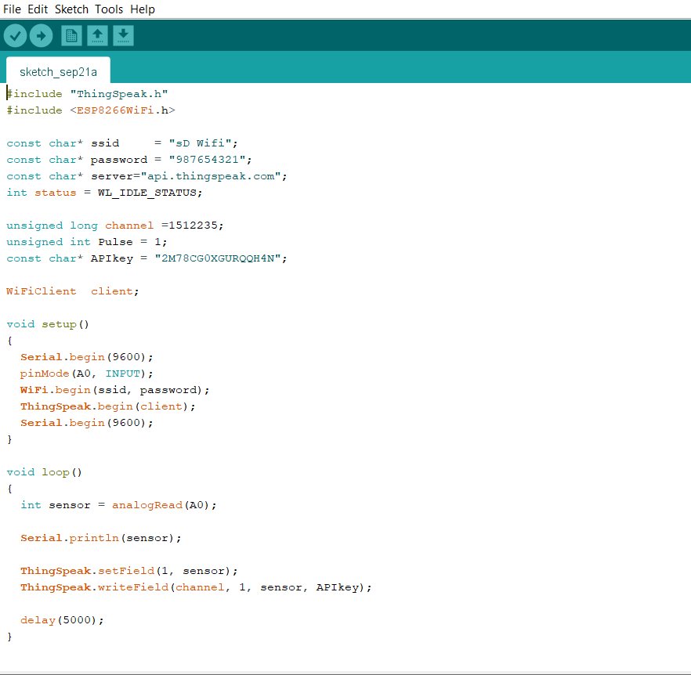
ARDUINO CODE
In this Arduino ide the ESP8266 & ThingSpeak libraries are used. Channel has been created in ThingSpeak & informations like Channel ID & API key have been put in this code which is then uploaded in ESP8266 WiFi module.

Slide 8
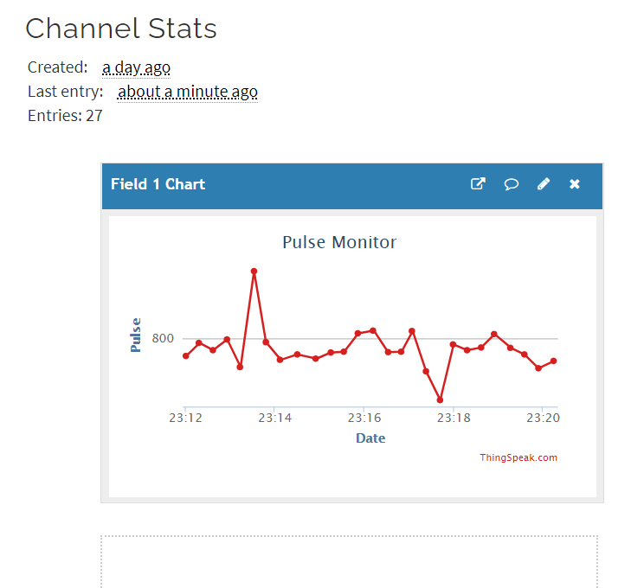
THINGSPEAK OUTPUT
The Channel Stats shows the pulse rate of the patient.
When the green light emitting from the pulse sensor passes along our skin, the equivalent pulse rate is obtained on the graph at regular interval.

Slide 9
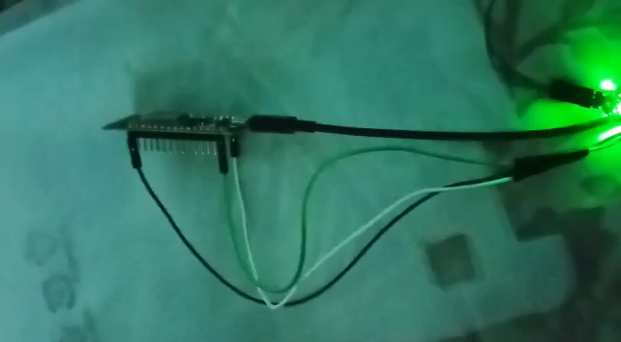
VIDEO DEMONSTARTION OF THE PROJECT

Slide 10
THANK YOU

